Slide 1

Mapping Census (ACS) Data Activity
Based on Hepworth & Church, 2018
Notes:
Icon: demographic by Nithinan Tatah from the Noun Project

Slide 2
Mapping Census Data Group Activity Instructions
Split class into groups of 5-6 people
Each group receives the same 2 maps showing Income Below Poverty by County in Mississippi.
Context: We want to understand the relationship between gender and poverty in Mississippi by county. Mississippi is one of the poorest states in the US.
Each group is given one of the following questions (only one question per group):
What conclusions would you draw about any effect of gender on poverty levels in Mississippi?
Are there any misleading components of the maps?
Is there any information that is missing that would be necessary for interpreting these maps?
Share each group’s question and their response and discuss all together
Notes:
If there are students who are not familiar with Census or American Community Survey data, a brief overview can be included.
Here is a good brief guide: https://guides.lib.berkeley.edu/USCensus/ACS

Slide 3
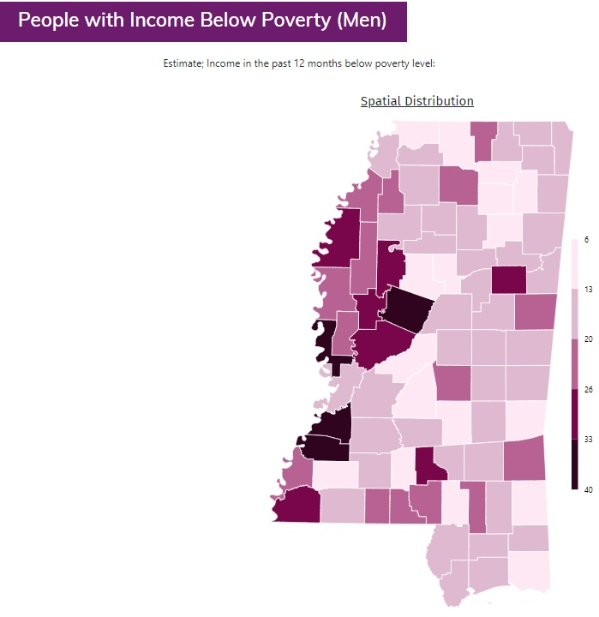
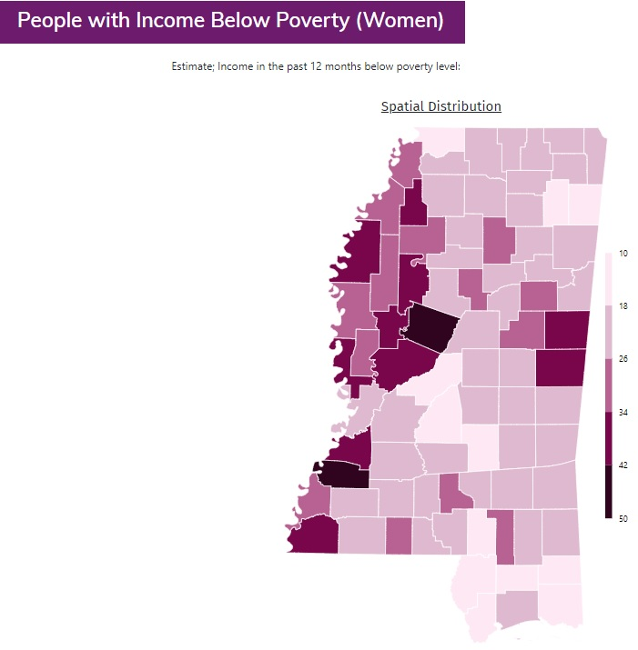
Mapping Census (ACS) Data: Poverty and Gender
Note: Maps display percent of each demographic group below poverty by county. Poverty thresholds vary depending on the size of the family unit and the number of children under 18 years in the family. In 2018, the poverty threshold for an individual under 65 years is $12,784. For a family of four (two parents, two children) the threshold is $25,465. For each additional child, the threshold increases by between $3,000 and $5,000. The thresholds for each year since 1978 can be found here: https://www.census.gov/data/tables/time-series/demo/income-poverty/historical-poverty-thresholds.html
Notes:
Instructor “solutions” for discussion after each group has shared their responses to their assigned questions:
Generally, the distribution across counties seems similar for men and women, with women experiencing higher levels of poverty overall and in some specific counties
The maps and note are missing specifics about the source of the data. Is it decennial Census? American Community Survey? From what year? Also missing north arrow, scale bar, label identifying the state as Mississippi.
For context, we might need to know the general population density for each county.
Advanced: the data classification method used results in different scales for each map, making it more difficult - or not possible - to make direct comparisons across groups

Slide 4
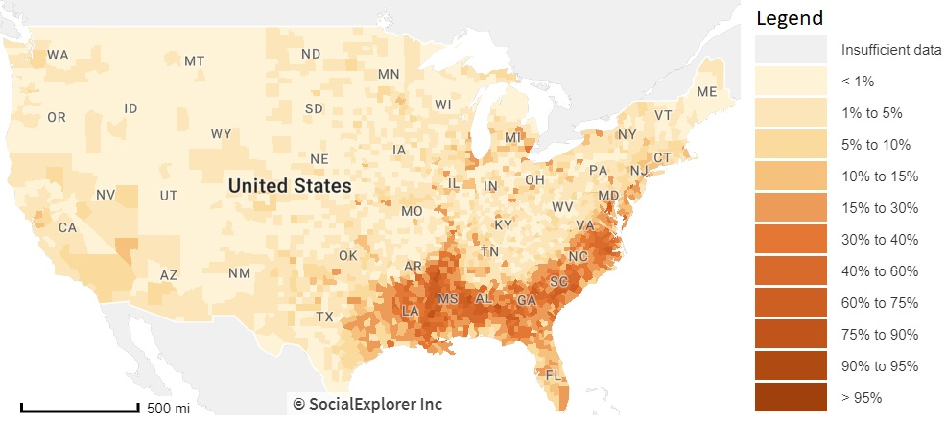
Mapping Census Data: A Critical Lens
A challenge with Census data: it is often stratified by one demographic variable (e.g. income below poverty by gender).
Consider Kimberlé Crenshaw’s theory of intersectionality
“Crenshaw describes the social construction of multiple identities as overlapping systems of discrimination.”
Also consider this map of the distribution of African-American people across the US by county:
Notes:
Sources:
Crenshaw, Kimberlé. 1989. "Demarginalizing the Intersection of Race and Sex: A Black Feminist Critique of Antidiscrimination Doctrine, Feminist Theory and Antiracist Politics." University of Chicago Legal Forum 1989, Article 8:139-167.
Koli, F., Nadasen, P. and Rod, A.B. “(Un)Privileging the Map: A Community Collaboration in Understanding Economic Security”, proceedings of the MAPPING (IN)JUSTICE SYMPOSIUM: Digital Theory + Praxis For Critical Scholarship, Fordham University, New York, New York, USA. (2019). Available at: https://mappinginjustice.org/unprivileging-the-map-a-community-collaboration-in-understanding-economic-security/

Slide 5
Challenging Assumptions
Did we know enough about the history of Mississippi to be able to interpret the relationship between poverty and gender?
Should the map creator(s) have investigated the intersection of race and gender as it relates to poverty in Mississippi?
Examining positionality: Who is benefitting from this work?
“Mapping inequality is not impactful in and of itself. Must continuously ask ourselves: are our practices creating the knowledge by which communities can build power?” (Koli 2019)
Notes:
Bonus: ask which step of the data visualization process relates to each assumption

Slide 6
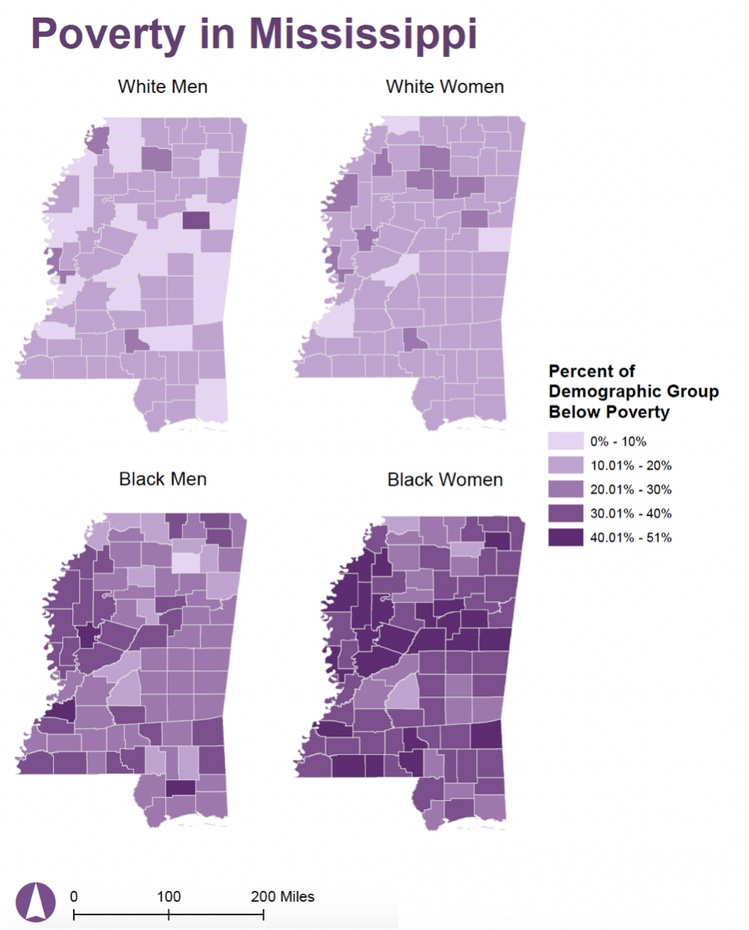
Mapping ACS Data: Race and Gender and Poverty
Source: 2012 ACS 5-year estimates. Koli, F. “(Un)Privileging the Map: A Community Collaboration in Understanding Economic Security.” Paper presented at the MAPPING (IN)JUSTICE SYMPOSIUM: Digital Theory + Praxis For Critical Scholarship. Fordham University / November 7-9 2019
Notes:
Discussion questions:
Now looking at poverty stratified by both race and gender, what do the visualizations reveal?
Which group is most affected by poverty across Mississippi?
Instructor notes:
Taking an intersectional approach looking at poverty by both race and gender reveals that Black women are most affected by poverty across Mississippi. It highlights the limitations of exploring gender absent race. Black men face higher rates of poverty than white women, but this would be rendered invisible if aggregated with data on white men
The power granted to maps and data, which in many cases can and has led to the reinforcement of oppressive structures, is also the reason why they have the potential to be used to bring attention to those oppressive structures.

Slide 7
Icon
demographic by Nithinan Tatah from the Noun Project

